Slide 1
Expressions
Most of a C ++ program is expressions.
An expression is some combination of literals and identifiers separated by operators.
Examples:
5 + x;
2;
++ y;
An operator, in computer programming, is a symbol that usually represents an action. These symbols were adapted from mathematics and logic. An operator is capable of manipulating a certain value or operand.
For example, operator + has two operands and the result is the sum of the operands.
Operator precedence determines the grouping of terms in an expression: Within an expression, higher precedence operators will be evaluated first.
The associativity of an operator is a property that determines how operators of the same precedence are grouped in the absence of parentheses.

Slide 2
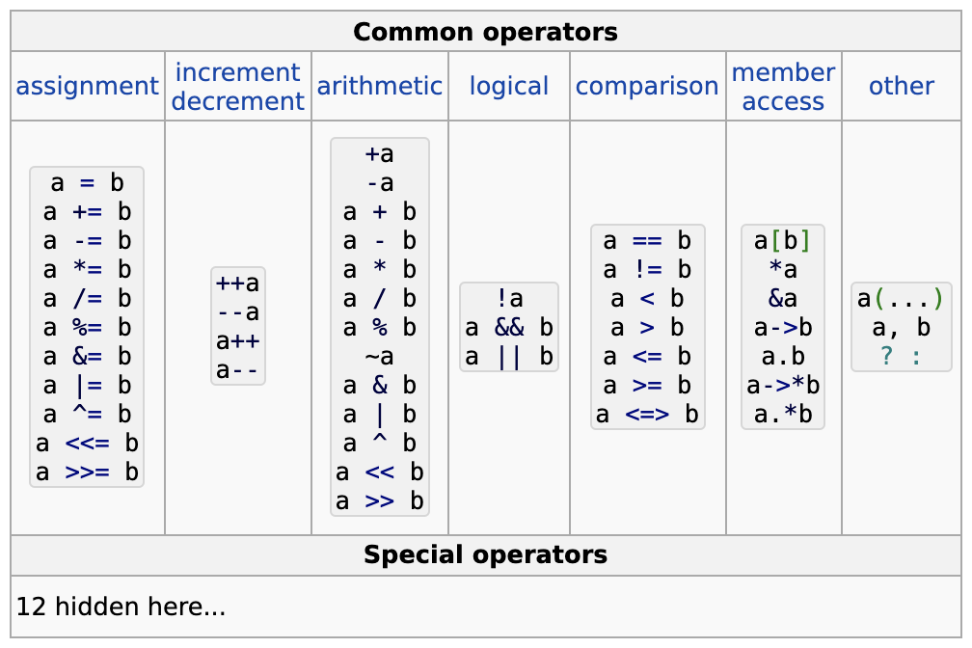
Operators

Slide 3
Assignment operator
Assignment operator is a binary operator: a = b value of a variable can be changed with the help of an assignment operator: x = 4
Precedence: 16.
Associativity: right-to-left
Note: Don’t confuse assignment operator with variable initialization!
Assignment operator:
int x;
x = 4;
Variable initialization:
int x = 3;
Note: Assignment operator returns the assigned value.
int x = 0;
std::cout << (x = 3) << std::endl;
Will print out 3, because x = 3 returns new value of x which is 3.
This idea can be used to assign multiple variables to the same value:
x = y = z = 3;

Slide 4
Lvalue and rvalue
lvalue and rvalue in C++ 07:
If a value can be used as the left operand of the assignment operator, then it is called an lvalue.
Otherwise, it is called an rvalue.
Note: In C++ 11 the value mechanism has been changed dramatically.
OK (x is an lvalue):
int x = 3;
int y = 5;
x = 7;
Incorrect (5 is an rvalue):
int x = 3;
5 = x;

Slide 5
Arithmetic operators
Binary operators:
Addition: a + b
Subtraction: a - b
Multiplication: a * b Division: a / b
Remainder: a % b
Presedence: *, /, % operators: 5
+, – operators: 6
Associativy: left-to-right
Unary operators:
Unary plus: + a
Unary minus: - a
Use case of unary –: int x = - y;
Use case of unary +: will be shown later.
Presedence: 3
Associativy: right-to-left
Note 1: In C++, division of two integers will also return integer: 7 / 3 = 2
Note 2: Remainder operator should be applied only to integer types: 7 % 3 = 1

Slide 6
Compound assignment arithmetic operators
Special binary operators +=, -=, *=, /=, %= are named compound assignment arithmetic operators.
Presedence: 16 (same as assignment operator)
Associativity: right-to-left (same as assignment operator)
Theese operators should be used to increase or decrease the value of the variable (let x be 5):
x *= 3;
Now x is 15.
Just like the assignment operator, left operand of compound assignment arithmetic operator should be lvalue (for example, this is prohibited: 5 += 4, because 5 is an rvalue and not an lvalue)
Just like the assignment operator, compound assignment arithmetic operators return the new value of the assigned variable (let x be 2 by default):
std::cout << (x -= 3) << std::endl;
Will print out -1, because x -= 3 returns new value of x, which is -1
This idea can be used to update multiple variables. For example (let x, y and z be 5 by default):
z /= x += y *= z %= x -= 3;

Slide 7
Increment and decrement operators
Unary operators:
Prefix increment: ++ a
Prefix decrement: -- a
Postfix increment: a ++ Postfix decrement: a --
Presedence: Postfix operators: 2
Prefix operators: 3 (Same as unary + and –)
Associativy: Postfix operators: left-to-right
Prefix operators: right-to-left
Note: Just like the compound assignment operators, increment and decrement operators should be provided with an lvalue as an operand.
Note: both prefix and postfix increment operators increase the value of the variable by 1. Both prefix and postfix decrement operators decrease the value of the variable by 1.
Note: prefix increment or decrement operators return the new value of the varible, when postfix increment and decrement operators return the previous value the variable
Example (let x be 0 by default):
std::cout << x++ << std::endl;
std::cout << ++x << std::endl;
Will print out 0 and then 2.

Slide 8
Comparison operators
Binary operators:
equal: a == b
not equal: a != b
less: a < b
less or equal: a <= b
greater: a > b greater or equal: a >= b
Presedence: Relational operators: 9
Equality operators: 10
Associativy: left-to-right
Note: theese operators are used to compare numbers, they return boolean value which indicates the result of the comparison.
Example:
int x = 4;
int y = 5;
std::cout << (x < y) << std::endl;
prints out 1 (true)
std::cout << (y == x) << std::endl;
prints out 0 (false)
etc…

Slide 9
Logical operators
Binary operators:
Logical not: !a
Logical and: a && b
Logical or: a || b
Presedence: Logical not: 3
Logical and: 14
Logical or: 15
Associativy: left-to-right
Note: theese operators are used to calculate the values ​​of logical expressions. Boolean values ​​are passed to these operators, and the output is also a Boolean value.
Example:
bool x = true;
bool y = false;
std::cout << (x && y) << std::endl;
prints out 0 (false)
std::cout << (x || y) << std::endl;
prints out 1 (true)
y = !y
std::cout << (x && y) << std::endl;
prints out 1 (true)

Slide 10
Operator sizeof
Operator sizeof:
Receives name of the type, literal, or identifier and returns an amount of bytes, needed for provided value to be stored in memory.
Examples (true for apple clang-1205.0.22.9 compiler and the majority of other compilers):
sizeof(int) returns 4
sizeof(54) also returns 4 (because 54 is int literal)
sizeof(123ull) returns 8 (because 123ull is an unsigned long long literal)
sizeof(‘a’) returns 1 (because ‘a’ is a char literal)
etc…

Slide 11
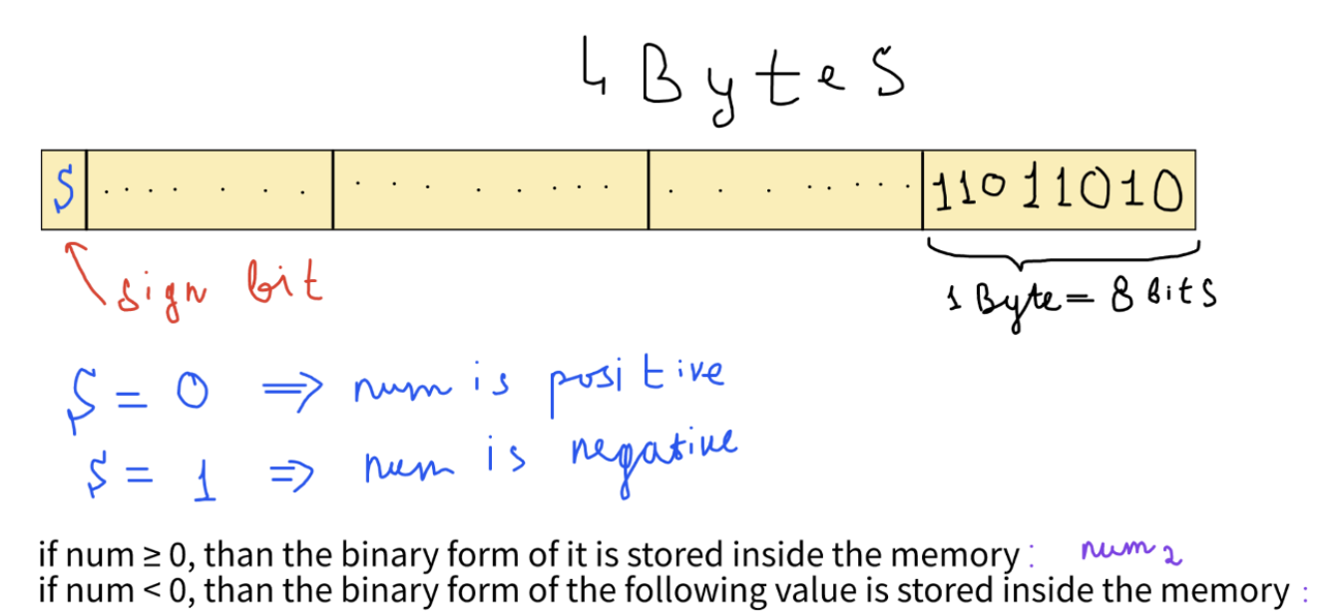
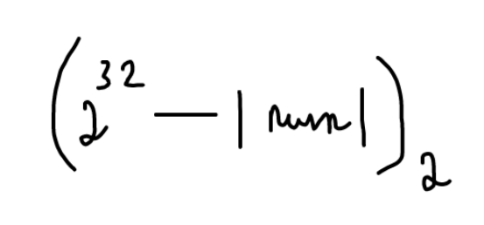
Storing integers in memory
Integer variables are stored as a sequence of bits (zeros or ones):

Slide 12
Storing other integer types in memory
The same mechanism is applied for other signed integer types (but size of the memory block will be different):
short: 2 Bytes
int : 4 Bytes
long : 4 Bytes
long long : 8 Bytes
Note: sizes of theese types are not standardized, i.e. they can be different, but the following rule must be preserved:
sizeof(short) ≤ sizeof(int) ≤ sizeof(long) ≤ sizeof(long long)

Slide 13
Storing unsigned integer types in memory
For unsigned integers, the formula is simpler: the binary form of the variable is just stored inside the memory, i.e. there is no sign bit for unsigned variables.
unsigned short: 2 Bytes
unsigned int (or just unsigned): 4 Bytes
unsigned long: 4 Bytes
unsigned long long : 8 Bytes

Slide 14
Bitwise operators
Unary operator:
Bitwise not: ~a
Binary operators:
Bitwise and: a & b
Bitwise xor: a ^ b
Bitwise or: a | b
Bitwise left shift: a << b
Bitwise right shift: a >> b
Presedence: Bitwise not: 3
Bitwise shifts: 7
Bitwise and: 11
Bitwise xor: 12
Bitwise or: 13
Associativy: left-to-right
Note: theese operators are used to operate with bits of the variables.
Semantics:
~a returns bitwise invertion of the number.
a & b, a | b, a ^ b applies and, or and xor operations to the variables a and b respectively.
a << b, a >> b shifts the binary representation of the number a by b bites to the left and right respectively.
Note: there is a compound assignment version of each binary bitwise operator: &=, ^=, |=, <<=, >>=
Presedence: 16
Associativity: right-to-left (same as every other assignement operator)

Slide 15
Ternary operator
Ternary operator:
a ? b : c
Presedence: 16 (same as assignement operators)
Associativy: left-to-right
Semantics:
a – boolean expression
b and c should be of the same type (or should be convertible to the same type)
Ternary operator returns b if a is true, otherwise c.
Example:
int a = 5;
int b = 3;
int max_two = (a > b) ? a : b;

Slide 16
Other operators
C-style cast:
(type)
Presedence: 3 (same as assignement operators)
Associativy: right-to-left
Semantics:
casts expression to the given type
Example:
unsigned short a = (unsigned short)5 + (unsigned short)true;

Slide 17
Scope resolution operator
Scope resolution (aka four dots operators):
::
Presedence: 1 (highest possible)
Associativy: left-to-right
Example:
std::cout << … << std::endl;

Slide 18
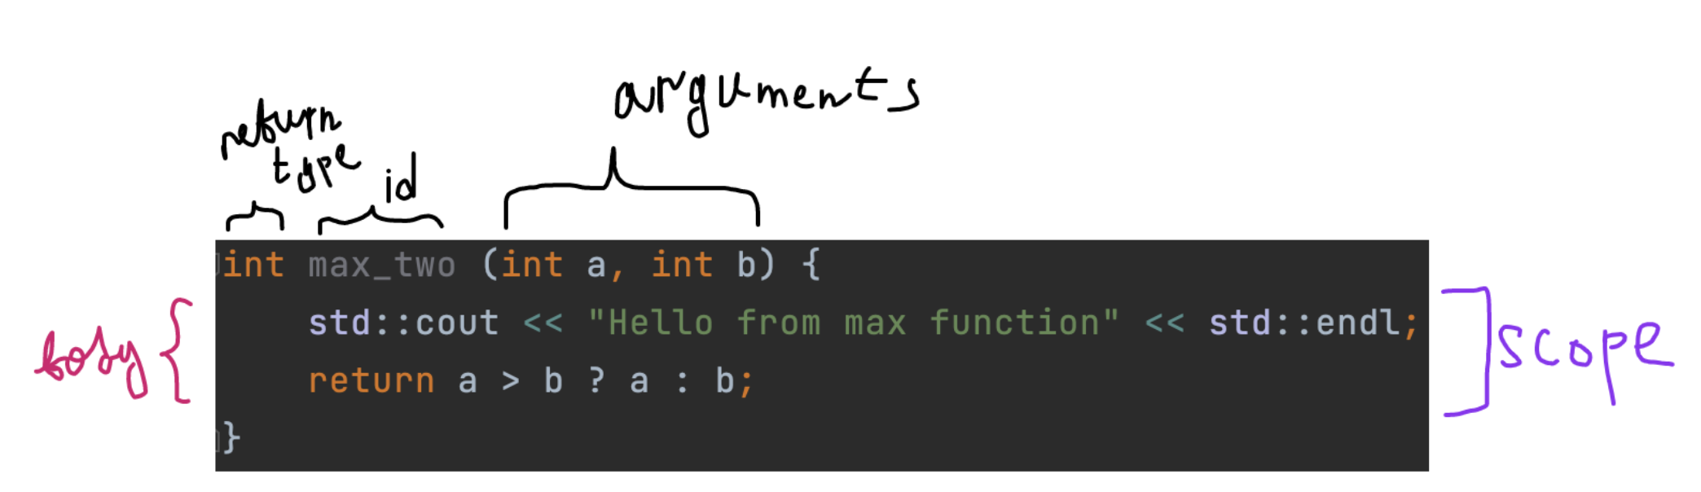
Functions
In C++, you can create functions in order to avoid copypaste and combine specific logic. For example, calculation of the n-th Fibbonacci number, or calculating max of two values.

Slide 19
Operator function call
In order to call your function, you should use operator function call:
func_id(arg1, arg2, …, argn);
Presedence: 2
Associativy: left-to-right
Note:
arguments are not guaranteed to be calculated sequentially from left to right!

Slide 20
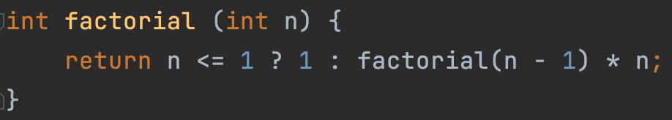
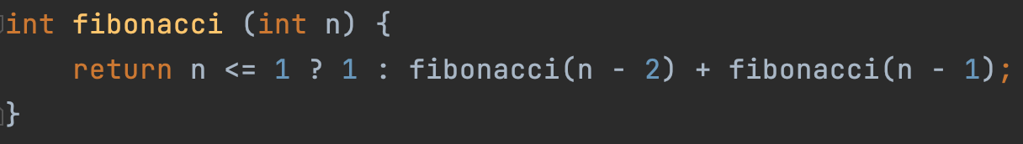
Recursion
In C++, you can call a function from within itself:

Slide 21
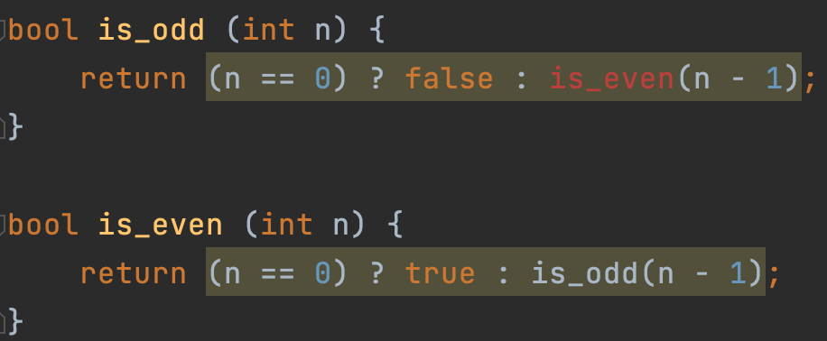
Function declaration
How to you compile this code =( ?

Slide 22
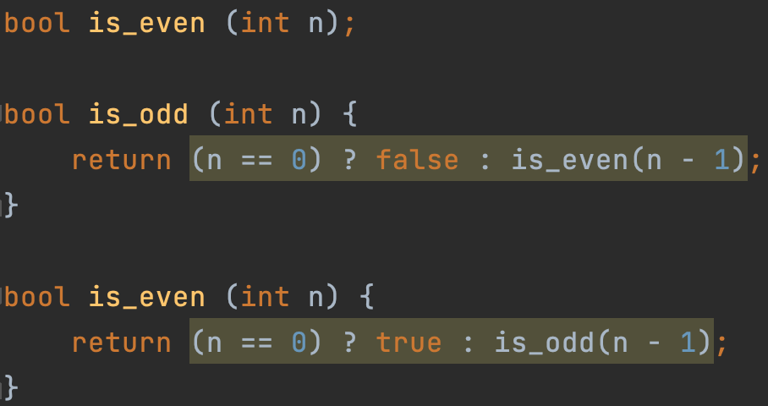
Function declaration
Solution: predeclare the second function:

Slide 23
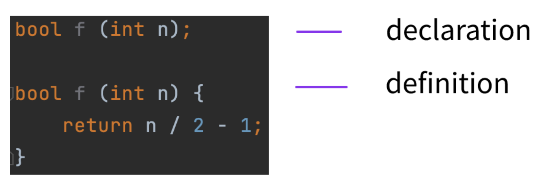
Declaration vs definition
Function can be declared multiple times, but should be defined only once!

Slide 24
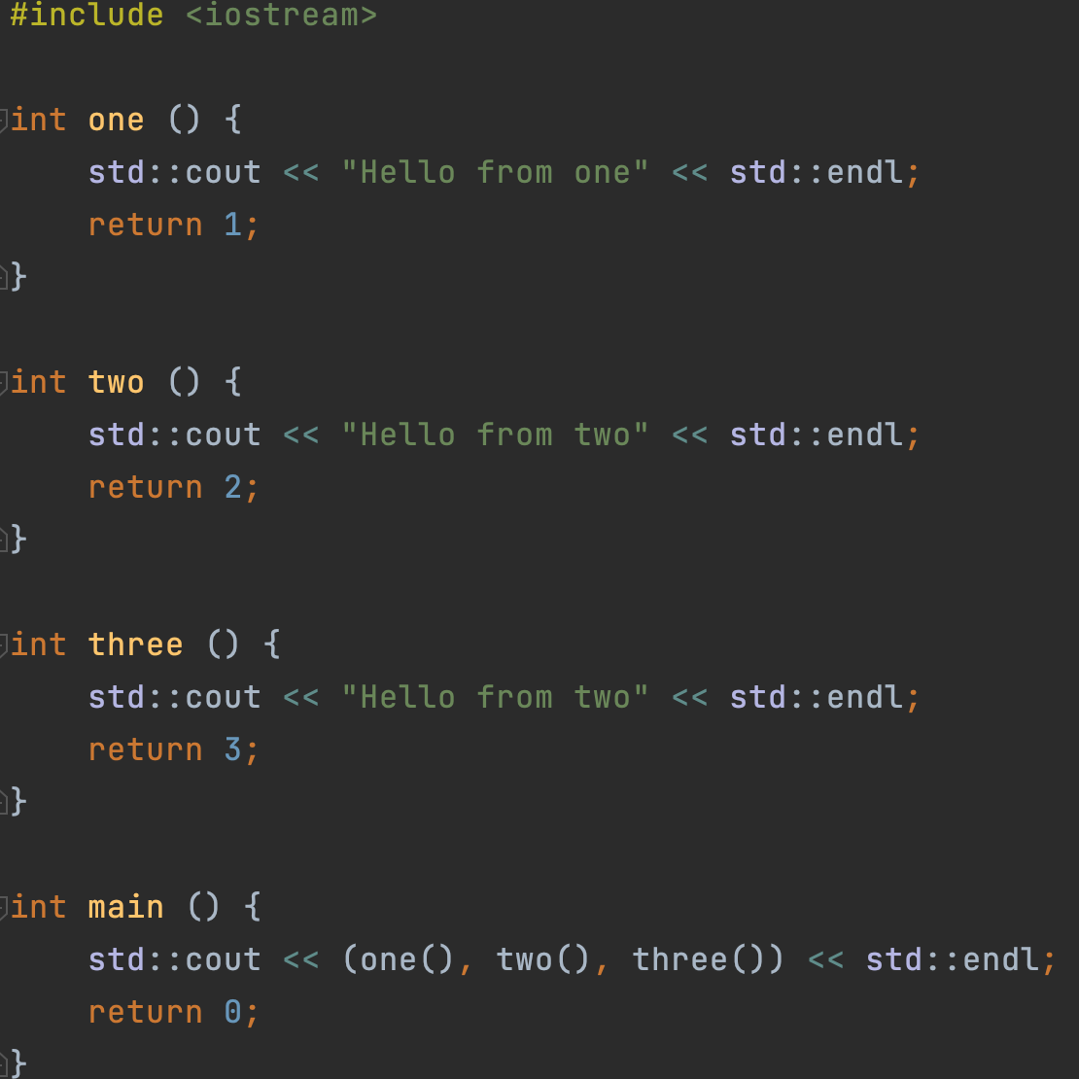
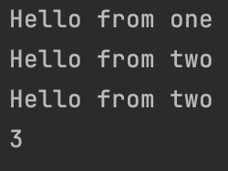
Comma operator
Comma operator:
,
Presedence: 17 (lowest possible)
Associativy: left-to-right
Usage:
Calculates the left argument, then the right argument and returns the result of right argument

Slide 25
Logical operators vs Bitwise operators
Optimisations:
In the case of operator &&, if the first argument evaluates to false, then, the second argument isn’t getting calculated, because the result of the expression can already be predicted.
The same rule is followed in the case of operator || if the first argument evaluates to true.
But there is no such rule for bitwise operators | and &
So, operators | and & are also applicable for boolean expressions too!
(If you want to force the calculation of both arguments)

Slide 26
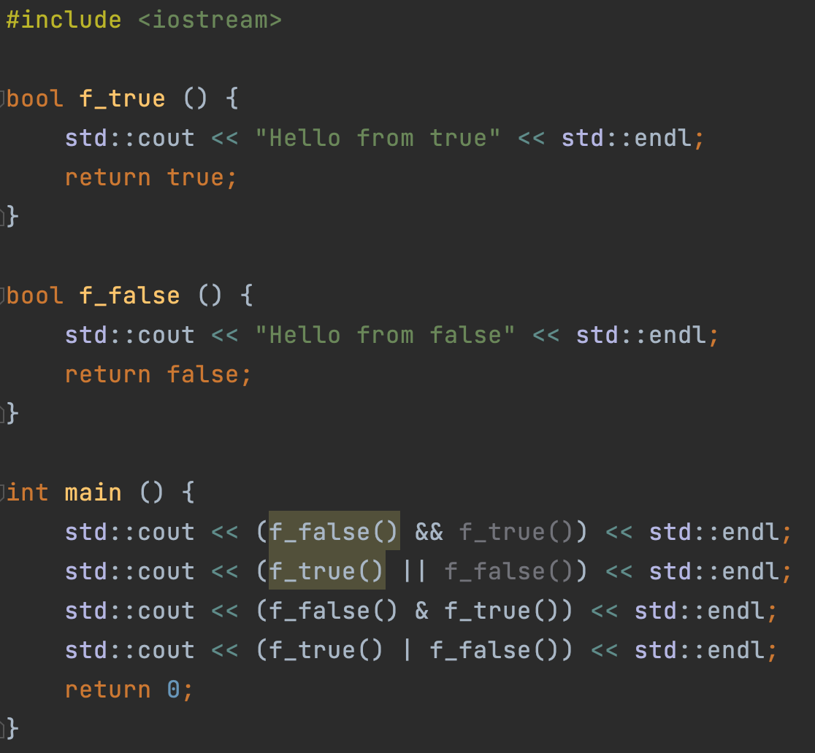
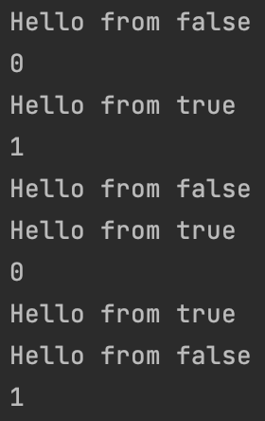
Logical operators vs Bitwise operators

